Slide 1

Breast Cancer Detector
Jennifer Vaughn

Slide 2
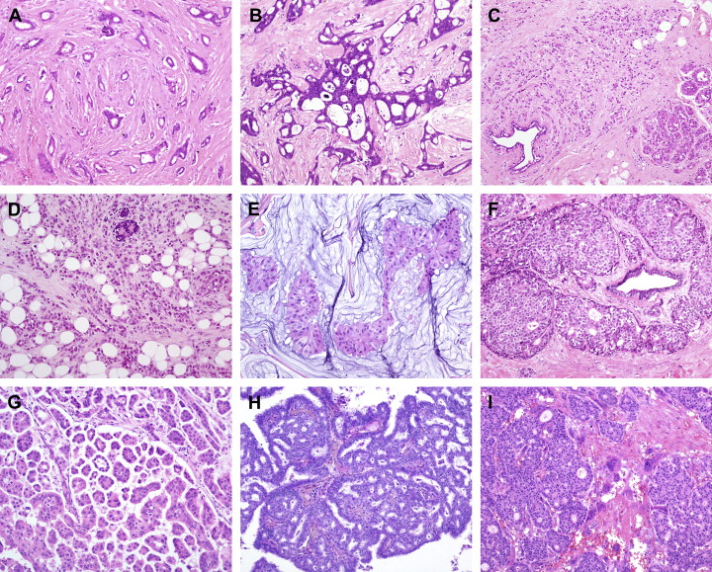
Topic and Objective
Invasive ductal carcinoma (IDC) is the most common form of breast cancer
Histopathology images are digitalized to allow for computer vision and image classification
Machine learning and deep learning can improve diagnostic accuracy for breast cancer
Task: Classify whether or not a patient has IDC based on histopathology images of their breast tissue.

Slide 3
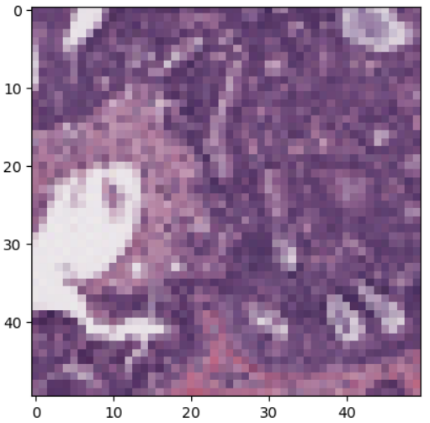
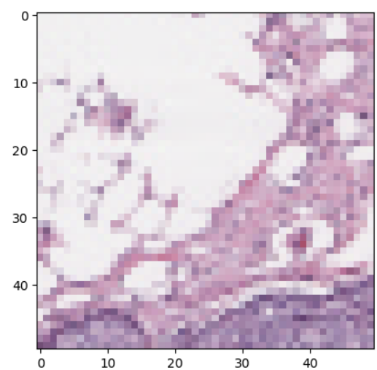
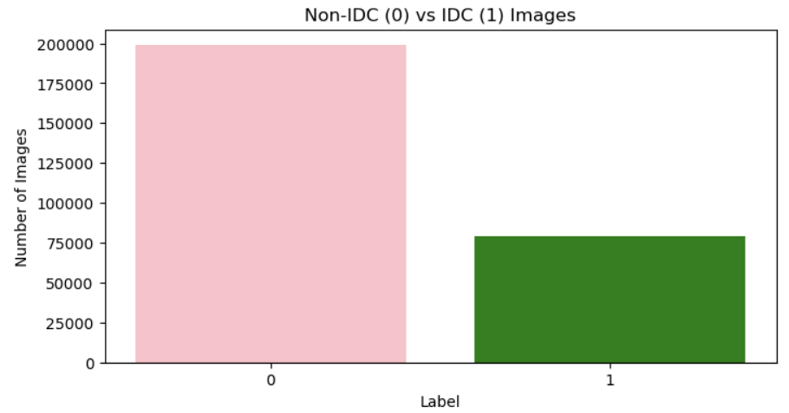
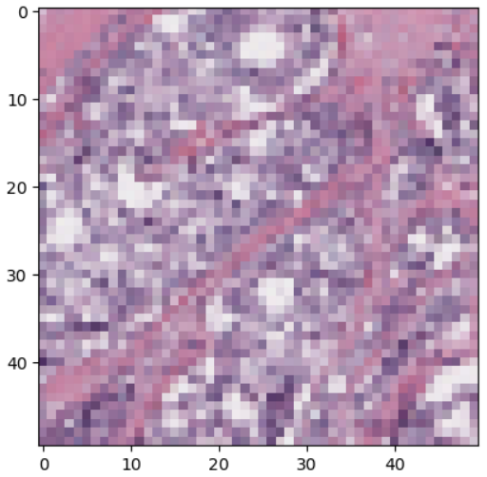
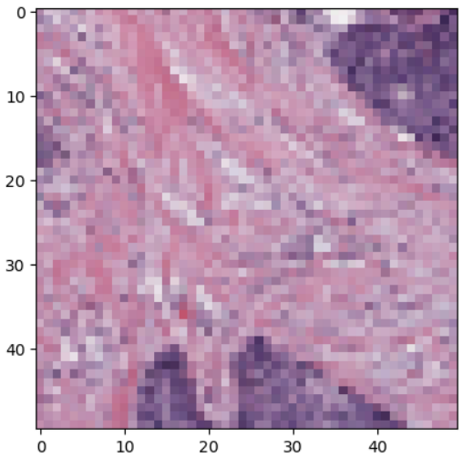
Data
Kaggle
279 patient folders, each containing images with IDC present and images with no IDC present
Supervised binary classification
277,524 PNG images of size 50x50

Slide 4
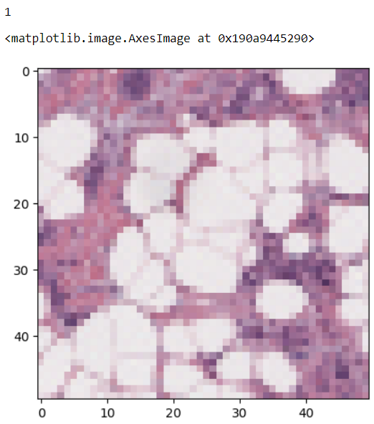
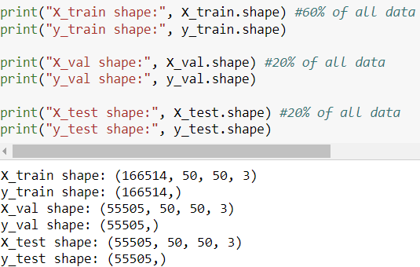
Data

Slide 5
Model Description
Convolutional Neural Network (CNN)
5-fold cross-validation (4 folds for training, 1 for validation)
F1-Score, Precision, Recall, and Accuracy to determine the best model
Epochs to update the model's weights
Early Stopping based on recall to avoid overfitting

Slide 6
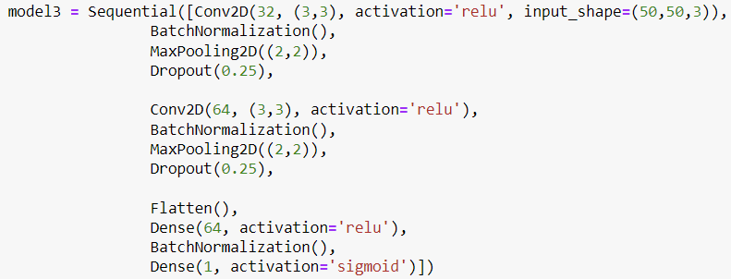
Results
 | CNN 1 | CNN 2 | CNN 3
Precision | 0.5973 | 0.8378 | 0.4189
Recall | 0.4701 | 0.4157 | 0.7597
F1-Score | 0.5089 | 0.5556 | 0.5400
Accuracy | 0.5991 | 0.8378 | 0.4189
Best model overall:
2 Convolutional layers with Batch Normalization, Max Pooling, and Dropout
1 Flatten layer
2 Dense layers

